Slide 1

Group Riding Clinic
Presented by
High Desert
Harley-Davidson
And
Intermountain Chapter
HOG

Slide 2
Riding Preparations
Mental
  Alert and Clear mind, free from influences of drugs or alcohol
Protective clothing
  Time of year
  Weather
Motorcycle
  T-CLOCK

Slide 3
Rider Ready
Be on time at rider meeting location
Bike fully prepped to go on first leg of ride
  Have a full tank of gas
  T-CLOCK completed
Follow Lead Riders itinerary of ride
  Even if you have been on the route before, don’t assume
Hand Signals

Slide 4
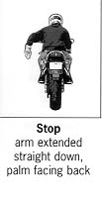
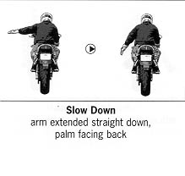
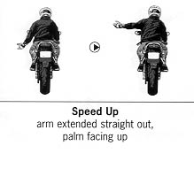
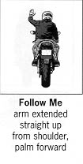
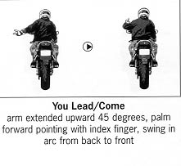
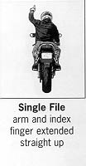
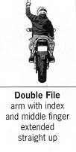
GROUP RIDING
Hand Signals

Slide 5
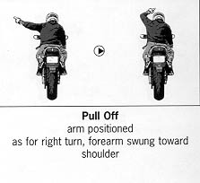
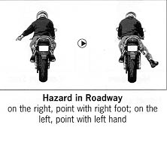
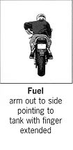
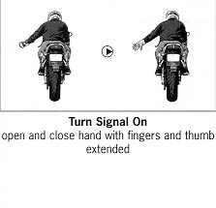
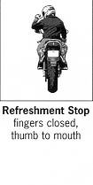
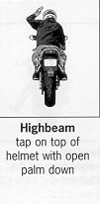
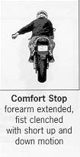
GROUP RIDING
Hand Signals-continued

Slide 6
Rider Location within Formation
Large groups (20+) will have 3 or more road captains
  Lead – will manage the ride, pre-brief and close ride at end point
  Mids - will know route, help direct ride should separation occur and render aid if needed, maintain communication with Lead and Sweep
  Sweep – will know route, stop and assist a rider unable to continue in ride, communicate with Lead and Mid of issue development

Slide 7
Rider Location within Formation
Novice and less experienced riders paired with a mentor
  Promotes support in riding techniques with group
  Shares improvements with novice riders skills
Encourage less experienced riders positioned towards rear of formation
  Decreases pressure to maintain too fast a pace and hopefully increase riding enjoyment
  Provide visibility to sweep for observation and provide assessment of rider skill level

Slide 8
Group Riding Formations
Staggered and Single file
  Staggered
    Generally used for the majority of road types
    Spacing interval 2 second. Increases in bad weather or poor road conditions
    Trikes ride in center of lane maintaining space of staggered pair of motorcycles
Single file
  Used for narrow, tight curves, limited visibility, entering/exiting highways or need for more maneuvering space

Slide 9


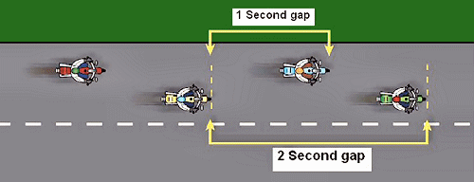
GROUP RIDING
Fuel up
Two second rule
Staggered formation

Slide 10
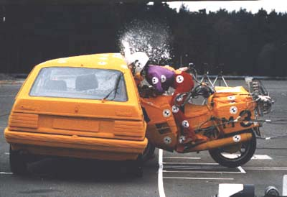
INTERSECTIONS
Most dangerous
Oncoming vehicle
Slow down
Downshift
Cover brakes
Evasive maneuver
Timing

Slide 11
City Traffic
Intersections, crossroads, congestion
  Curb, turning and parking lanes
    Widen staggered formation for rapid change of direction
  Center lane more conductive for point to point travel
Traffic Lights, Stop signs
  Obey traffic laws as you would in your cages
  Each rider must act independently, safely and legally
    Road Captains or leaders of the ride should make known during the pre-ride briefing ride directions and route so no one feels pressured to “race” to catch up to the group

Slide 12
City Traffic
At intersections
  Do not block or hold up crossing traffic, it is illegal
  Leaders should not make a turn on a red light
    waiting for the light to change will enhance the entire groups chances to pass through together
Cornering, Left and Right turns
  Each rider is an individual, proceeding through or making a turn when it is safe and legal

Slide 13
Passing & Lane Changes
Lead must determine the need
  Can entire group pass as unit or require individual pass
  How close to destination or road change/exit
  Is pass really a benefit or increases risk to group
Highway (Snake) pass
  Lead checks for clearance (determines safety of group) and signals to begin pass. Each individual checks rearview, signals and begins pass
  Sweep, recognizing the pass, can assist for those ahead

Slide 14
Passing & Lane Changes
Two Lane and low visibility roads
  Individual passes one at a time
    Following each riders pass, the next rider moves up and passes when it is safe and legal to do so
    After the pass, each rider should move ahead leaving room for the next rider to safely pass.
    Using marked and legal passing zones encourages a courteous response from those being passed, enhancing our road presence
  Communication
    With newer Harleys use of radio communication will enhance safety for all

Slide 15
Parking
Lead riders should have prior considerations made for parking a group at a location
  Follow their lead, whether it is a pull through (easiest to arrive and depart) or a 90 degree stop (backing in against a curb/fence/designated parking spot)
  Avoid parking downhill or head-in
  A “free-for-all” never seems to work out very well

Slide 16
Safety in
GROUP RIDING
Two Keys for rider awareness
Target fixation
&
Accordion effect

Slide 17
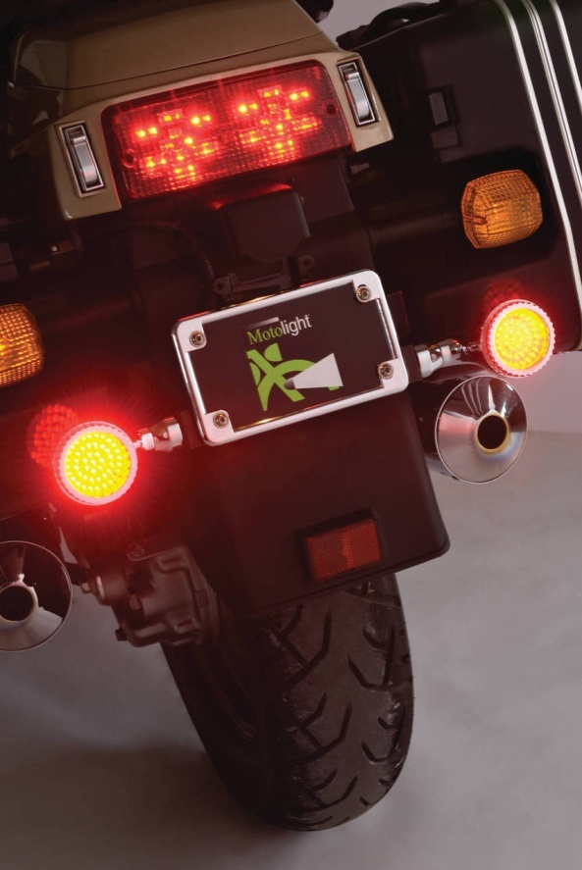
Safety in
VISABILITY
Lights
Clothing
Reflective gear
Signals
Horn
Position

Slide 18
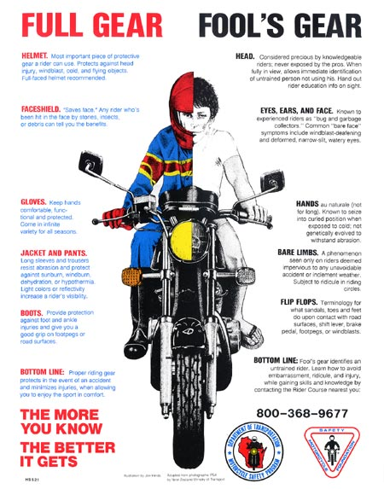

Slide 19
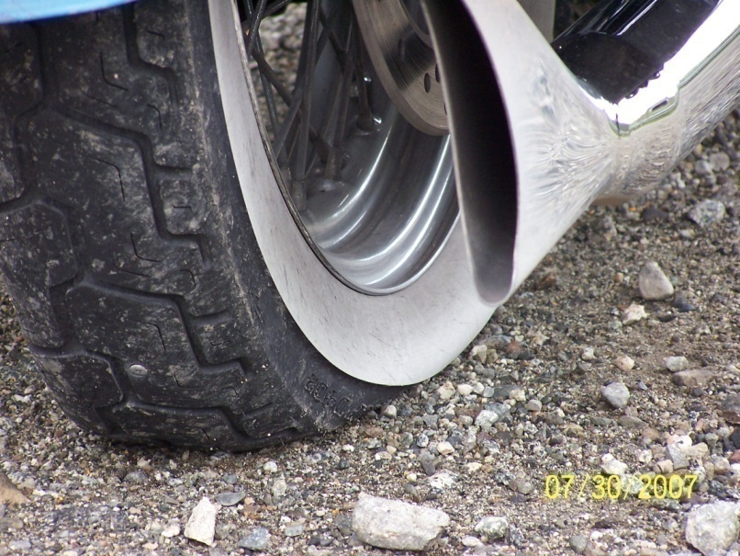
Safety in
MAINTENANCE
Regular service
Keep it clean
Tool kit
Owners manual
Tire pressure
Oil level

Slide 20
EVEN OLD DOGS CAN LEARN NEW TRICKS!!
Safe riding requires knowledge, experience, skills and practice
Rider courses: Stars, MSF, Learn to Ride @ HDHD
Group riding
Intersections
Visibility
Riding gear
Maintenance

Slide 21
GROUP RIDING
When riding as a group you will never be left behind or left without instruction.
We have all been new to riding and to the Chapter at some point…please ask questions!
We are all here to help you, and we may depend on you for help someday too!

Slide 22
QUESTIONS - COMMENTS??
THANK YOU FOR ATTENDING!!

